Slide 1
DATASCI 450: Deriving Knowledge from Data at Scale
Data Science Rocks
Sayed Rizvi

Slide 2
Overview
 | How long did you spend in this phase? (mins/days) | Additional Notes
Understanding the data | One week.
Data Exploration | Two weeks.
Features / Feature Engineering | One week.
Building the Model | 2 days.
Evaluating the Model | 1 day.
Operationalizing the model (Optional)
Note – Add additional steps/phases

Slide 3
Data
The aim of this competition is to predict the sale price of each property. The target variable is called price_doc in train.csv.
The training data is from August 2011 to June 2015, and the test set is from July 2015 to May 2016. The dataset also includes information about overall conditions in Russia's economy and finance sector, so you can focus on generating accurate price forecasts for individual properties, without needing to second-guess what the business cycle will do.
train.csv, test.csv: information about individual transactions. The rows are indexed by the "id" field, which refers to individual transactions (particular properties might appear more than once, in separate transactions). These files also include supplementary information about the local area of each property.
Original training data had 30471 observations with 292 variables, last variable is price_doc with the house price and will be used as a label to train the model.
Original test data had 7662 observations with 291 features.
macro.csv: data on Russia's macroeconomy and financial sector (could be joined to the train and test sets on the "timestamp" column)
Here we have 2484 observation based 100 variables, I have merged this data in to training data by “timestamp’ column.
sample_submission.csv: an example submission file in the correct format
data_dictionary.txt: explanations of the fields available in the other data files

Slide 4
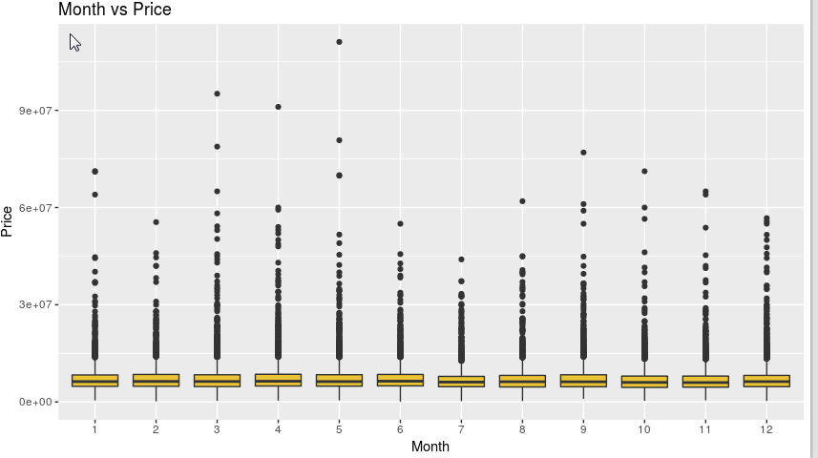
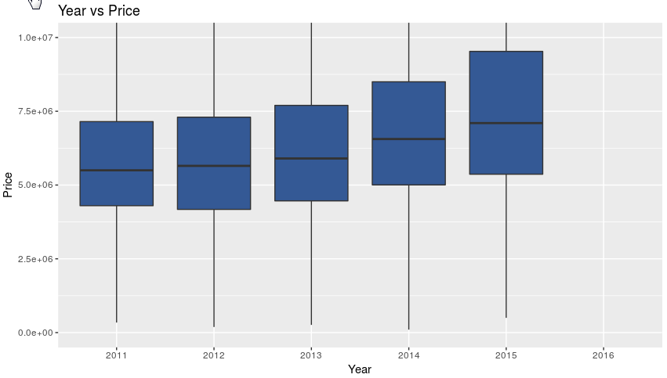
Data Visualizations : Price of house versus month & year.

Slide 5
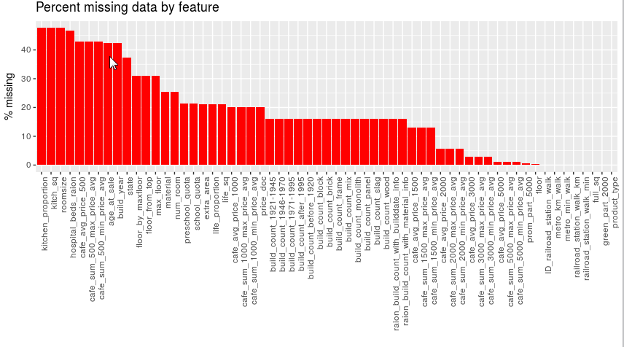
Data: Graph of feature with missing data.

Slide 6
Features
What are the features selected?
Out of 391 features (291 from training and 100 from macro data), I have selected 259 features.
Key step was to ensure that I converted all factor data to numeric for xGBoost model. This was done across train, test and macro data.
Why did you select the features?
I first cleaned up extraneous records in the training data table by using the filter function from dplyr package.
Converted all character columns to numeric so I could use nearZeroVar function from caret package to get a list of variables with near zero variance. I moved on to remove 34 variables from both test and training data tables.

Slide 7
Features
Next step was to use map_dbl function from “purrr” package, wherein I called a custom function to calculate percentage of NA’s in each column, map_dbl returned me a named list. Following best practices, I then moved on to remove 74 features with more than 5 % of NA’s. I then moved to onto impute 14 features with the median value. This task was done using impute function from Hmisc package.
As a final step I used the “Boruta” package to remove all unnecessary features. This run removed 21 variables.
As a final step I removed “id” and “timestamp” features to avoid overfitting in the model.

Slide 8
Features Engineering
Describe any data transformation steps
Combined train and test data, this data table was then merged with macro data using “timestamp”.
All features belonging to “factor” and “character” class were recast as numeric.
Features with classification data were transformed over to numeric values.
What did you do to transform the data?
Used rbind and merge functions for bullet # 1 above.
Used a for loop for bullet # 3 to iterate through the merged dataset and used as.numeric function to recast each feature picked up in the loop.
Use mutate function for bullet # 3.

Slide 9
Model Building
What was the machine learning algorithm used?
eXtreme Gradient Boosting.
Did you consider using any ensemble approach? Is that useful and applicable in this challenge?
No.
What tools did you use?
RStudio running on an AWS instance with the following configuration.
Model | vCPUs | Memory (GiB) | Networking Performance | Volume
r4.16xlarge | 64 | 488 | 20 Gigabit | 250GB

Slide 10
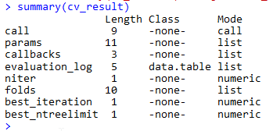
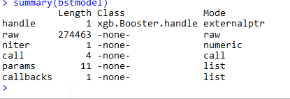
Model Building
Include
Screenshot of cross validation with both train and test data, here I am using xgb.cv and generating the “nrounds” value by using “early_stopping_rounds” parameter.
Screenshot of my model. Here I am using the xgb.train function to train the model.

Slide 11
Model Evaluation
Highlight any key achievements
Testing a model with an external data file wherein I could not change the number of observations was a challenge.
Adding macro data to this equation made it even more interesting.
What are your main metrics?
RMSE using xgb.cv (cross validation). My best number has been 0.389.

Slide 12
Key Learning
I was able to successfully create the model by applying all the knowledge I have gathered in this program.
It is very important to complete all the class assignments to successfully complete the capstone project.

